Slide 1
Microburst Isotropy vs Background Isotropy

Slide 2
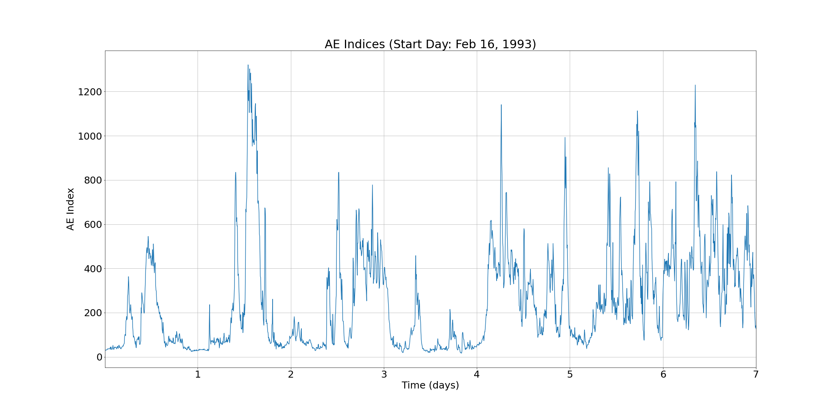
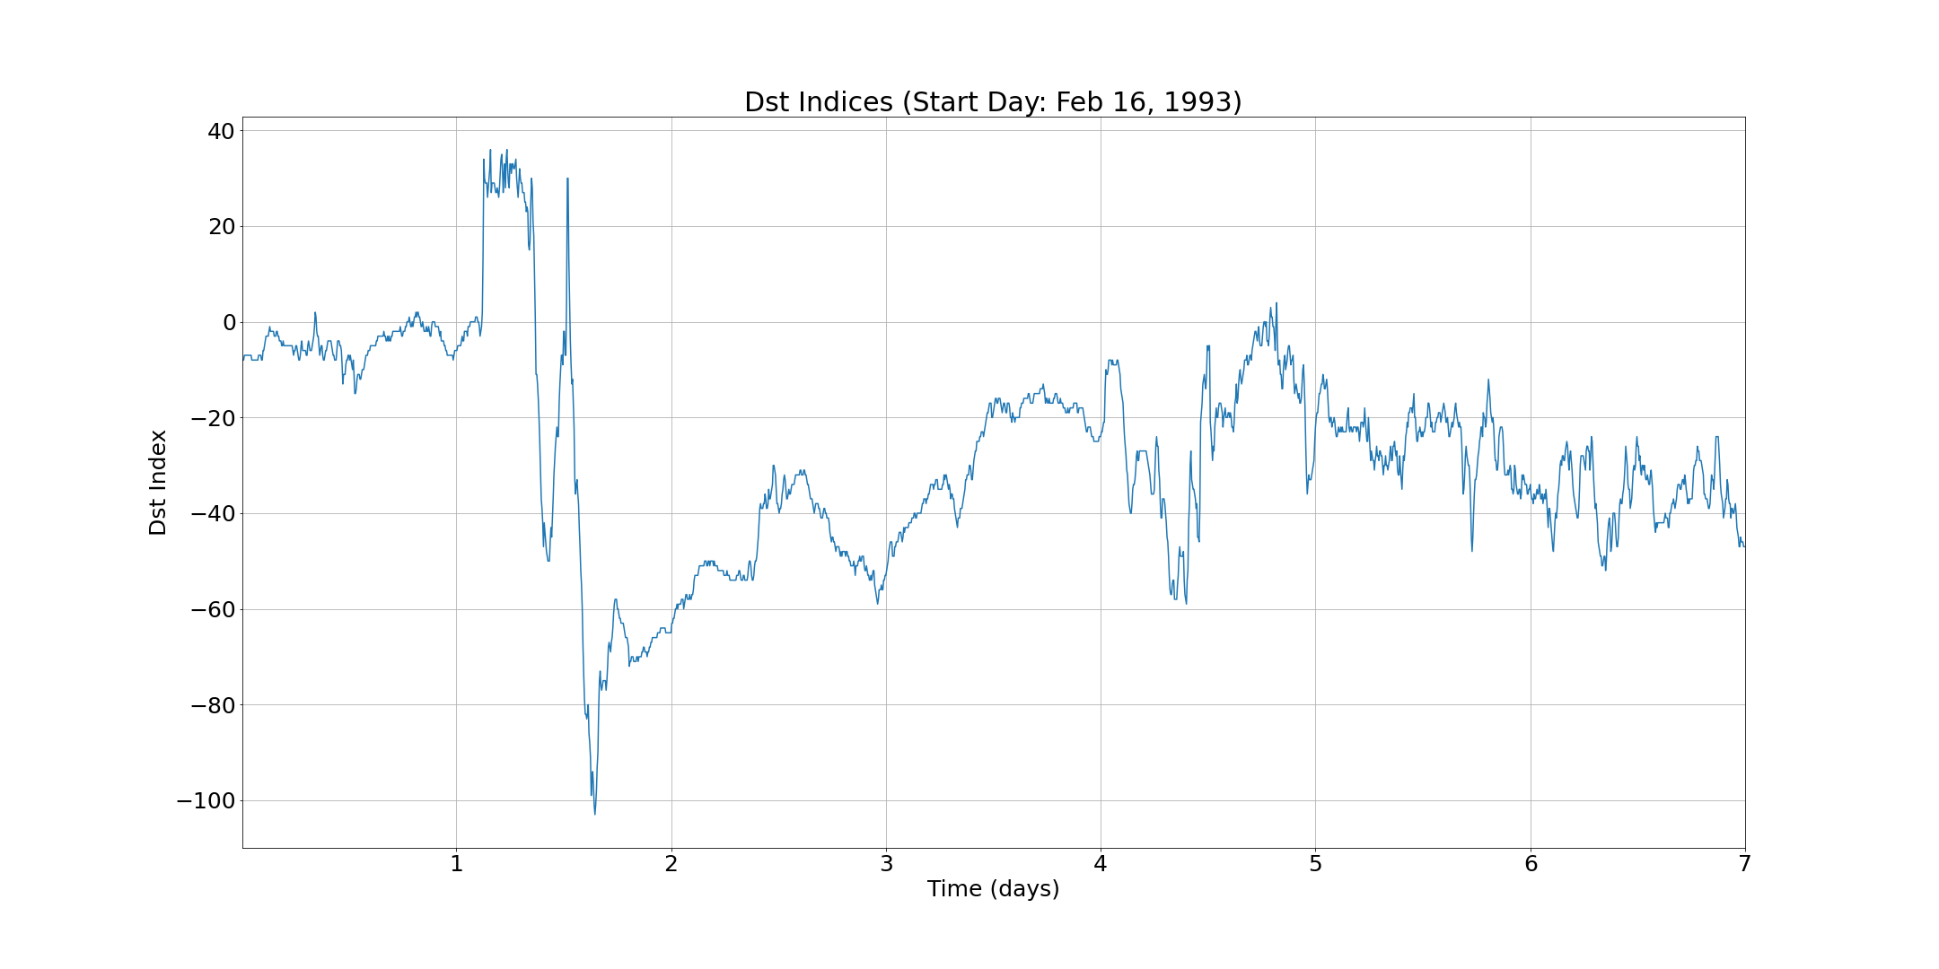

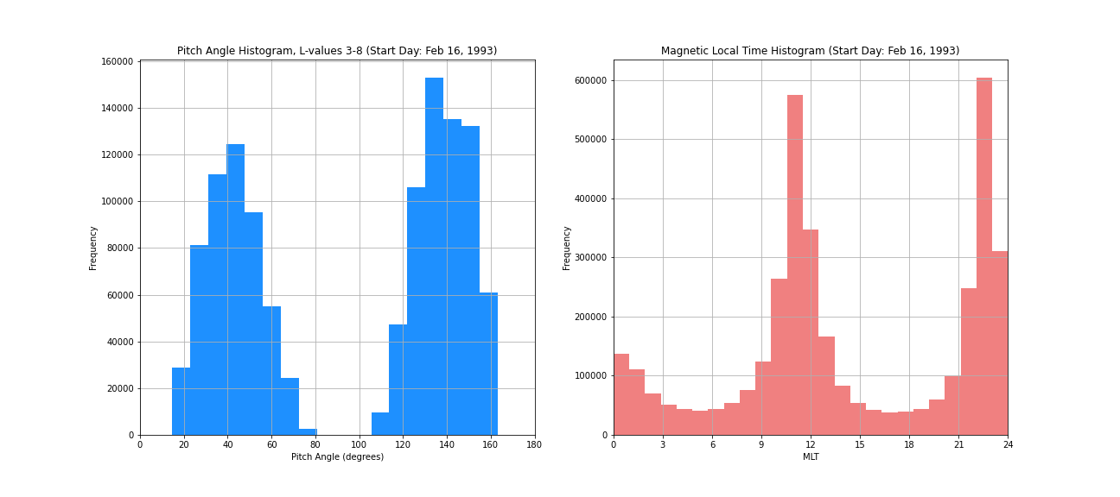

Storm 1: 1993047-1993053
Very few microbursts during AE lows
Storm type 1

Slide 3
Storm 2: 1993067-1993069
Removed: too short

Slide 4
Storm 3: 1993070-1993071
Removed: too short

Slide 5
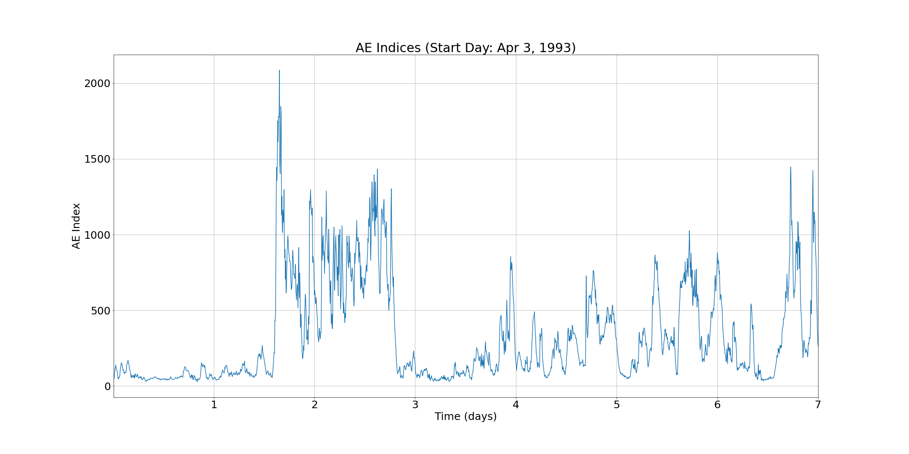
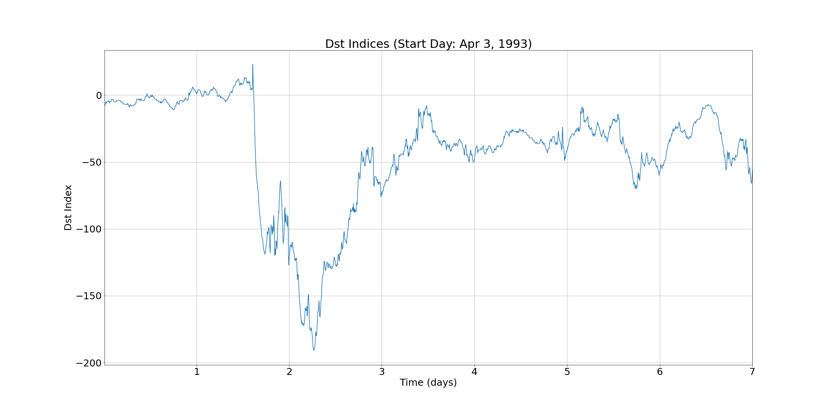

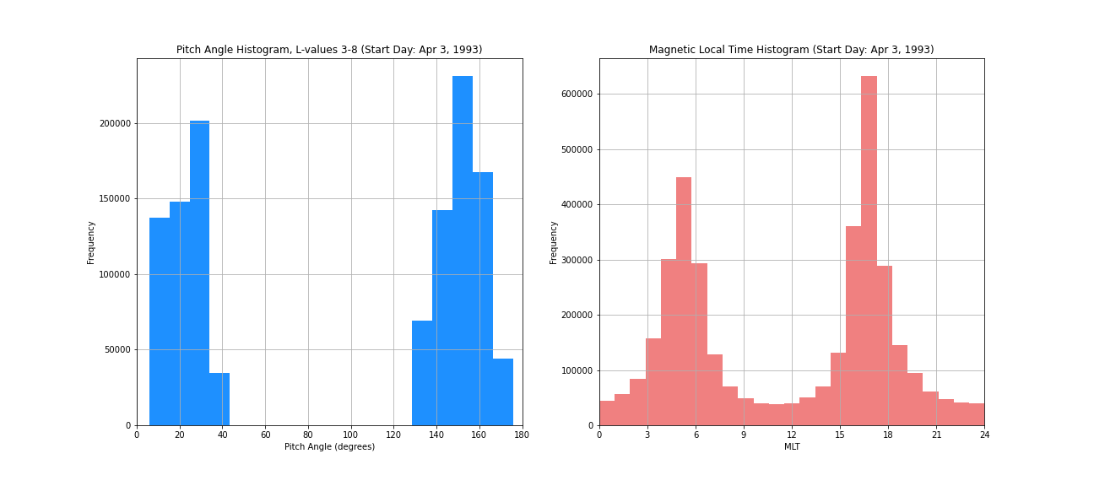

Storm 4: 1993093-1993099
Storm type 2
Chosen for report

Slide 6
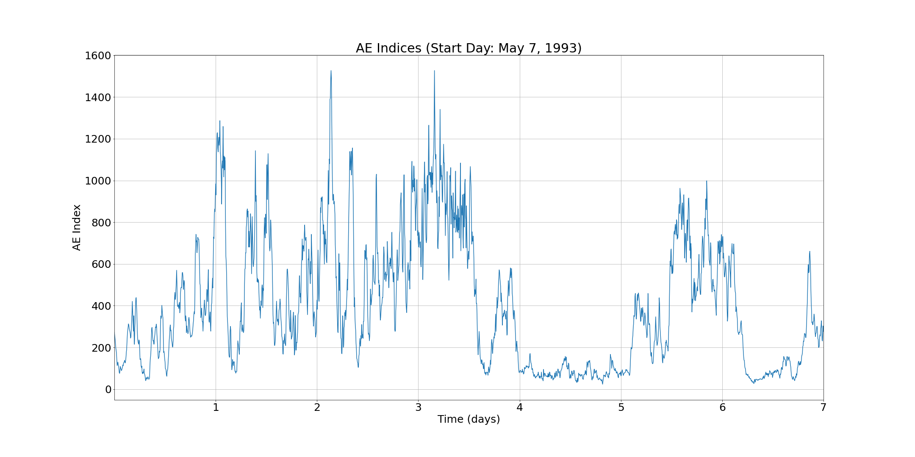
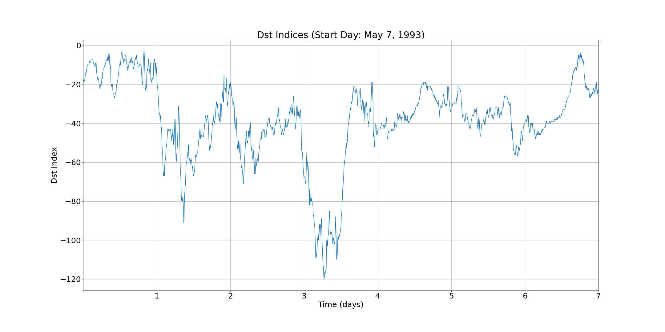

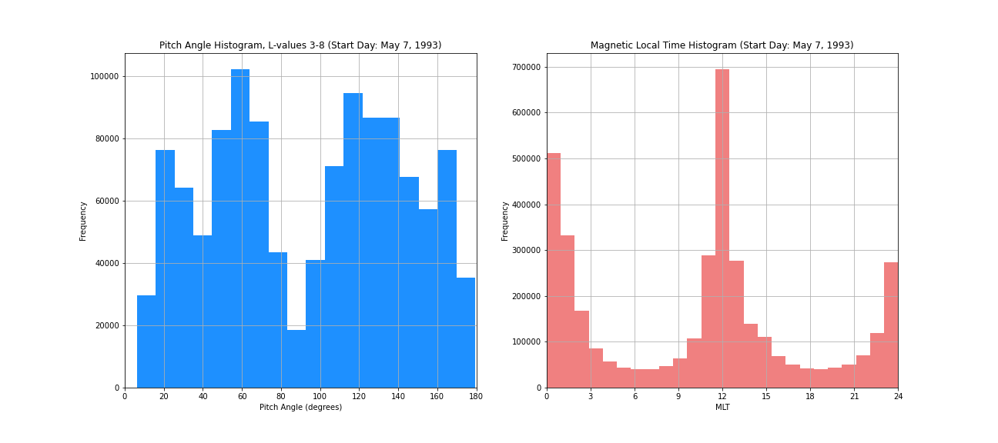

Storm 5: 1993127-1993133
Very few microbursts during AE lows
Storm type 1
Chosen for report

Slide 7
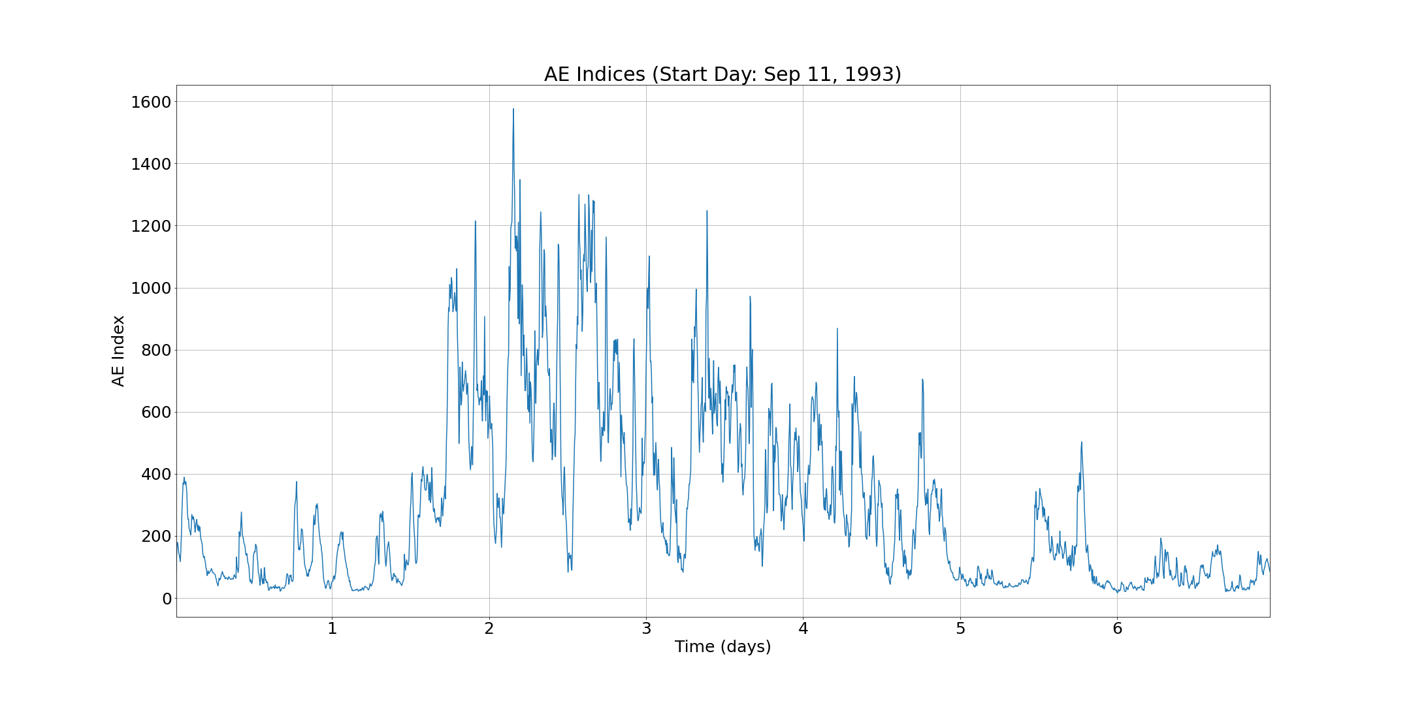
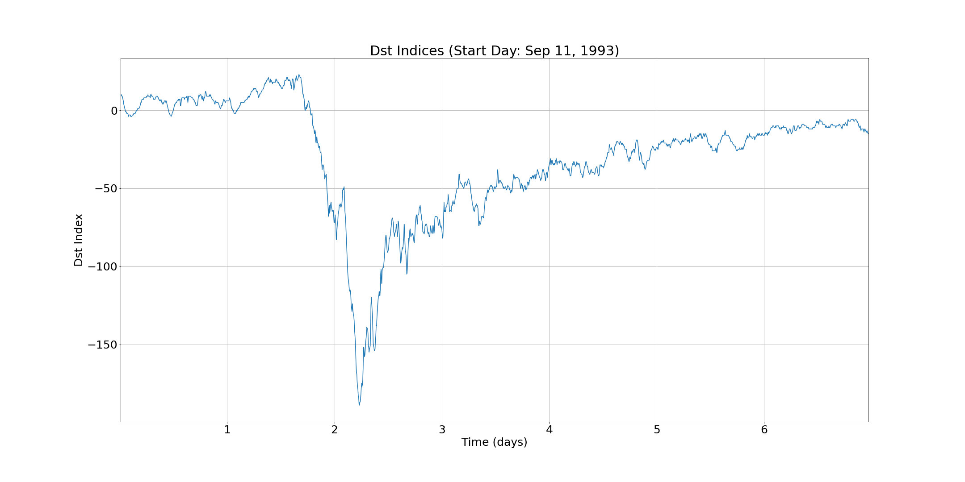

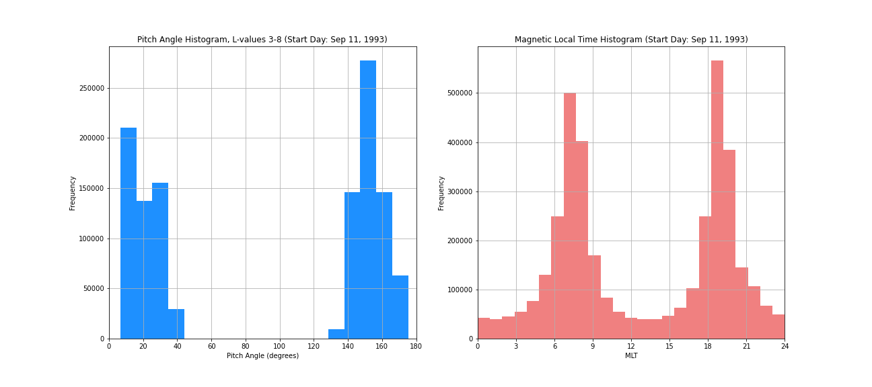

Storm 6: 1993254-1993260
Storm type 2
Chosen for report

Slide 8
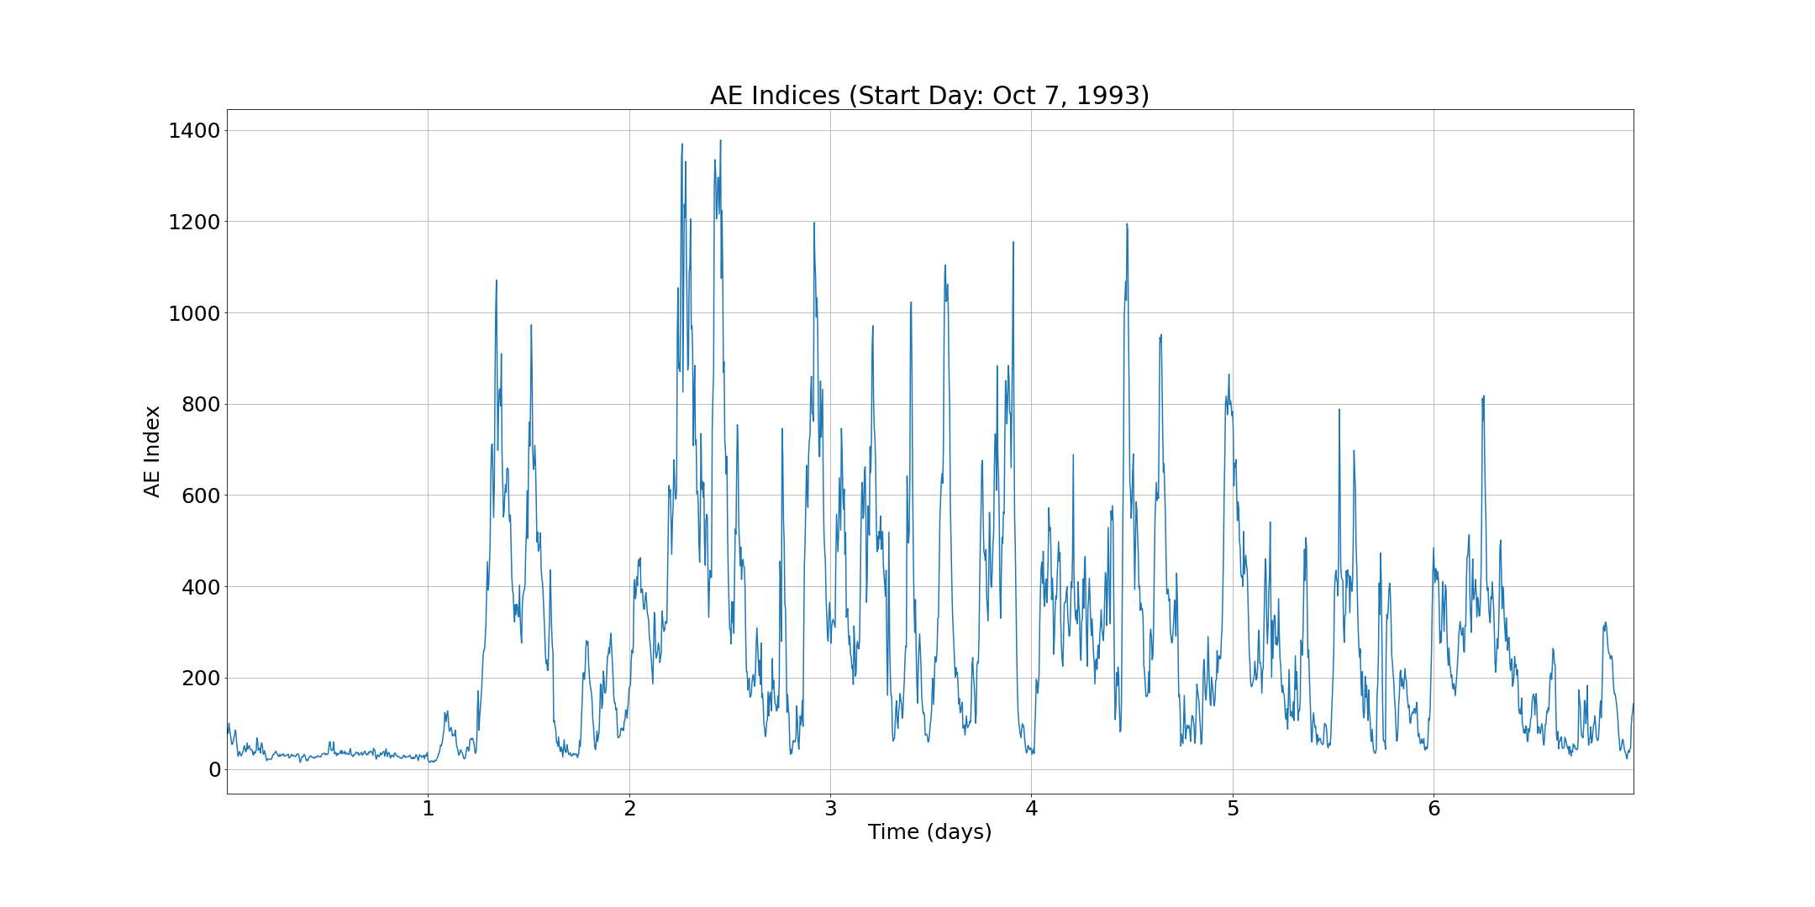
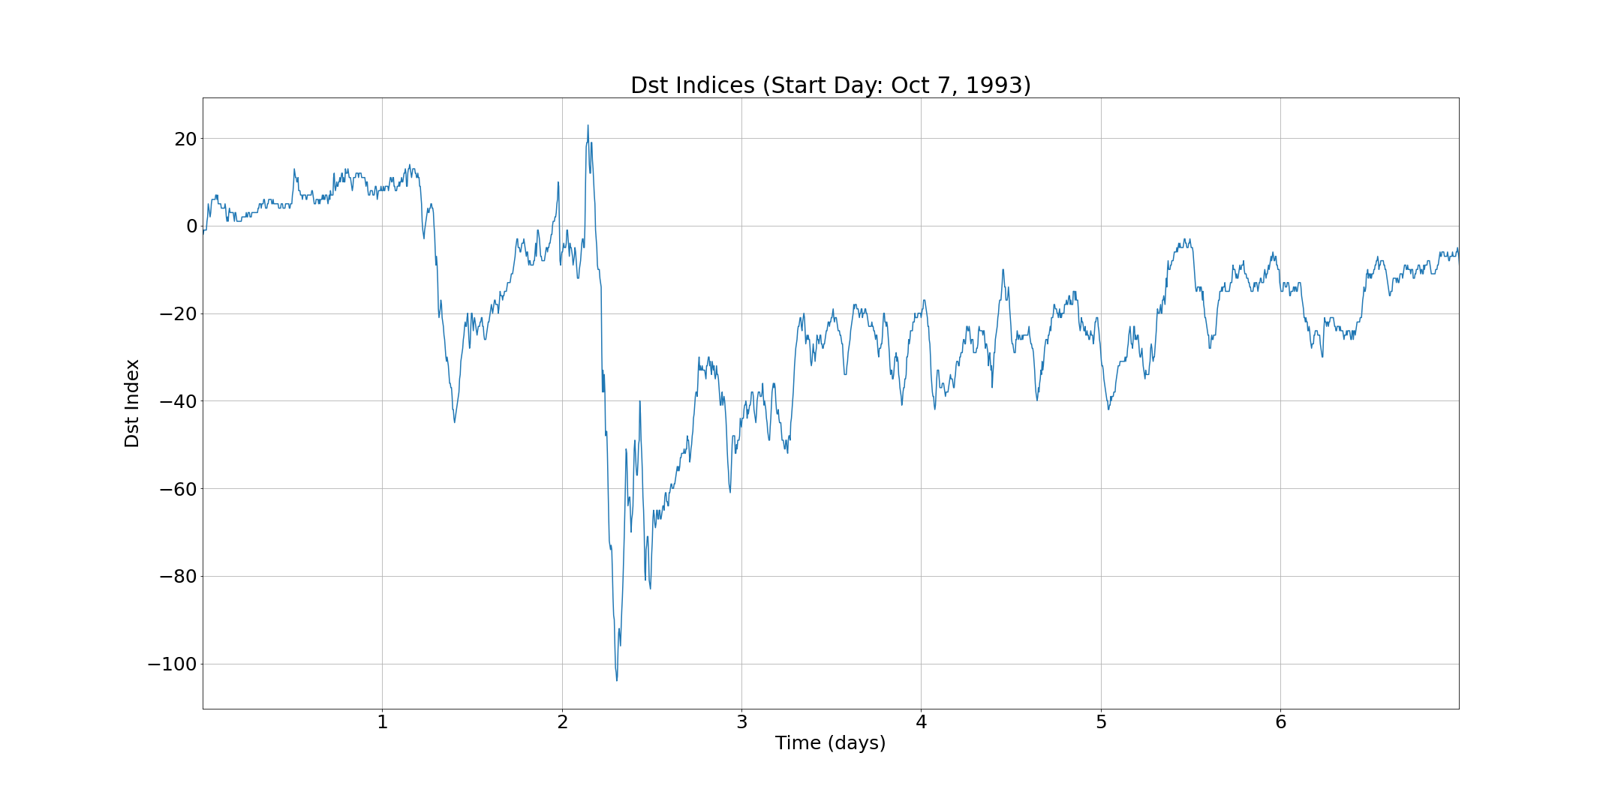

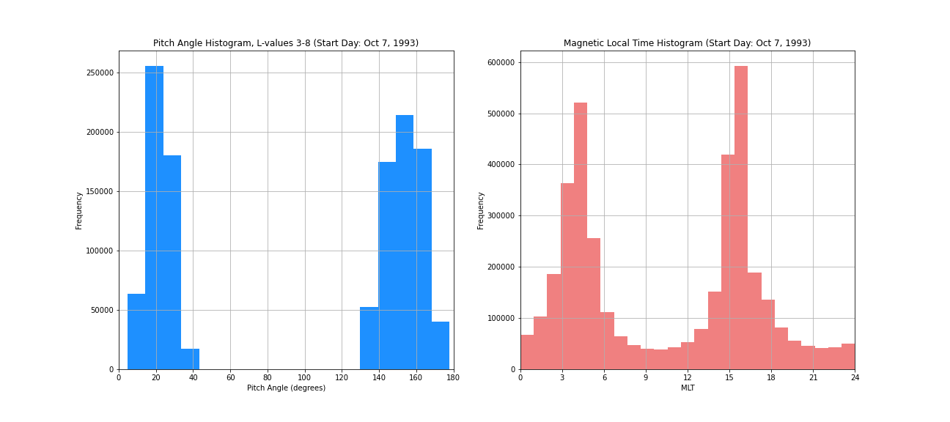

Storm 7: 1993280-1993286
Storm type 2

Slide 9
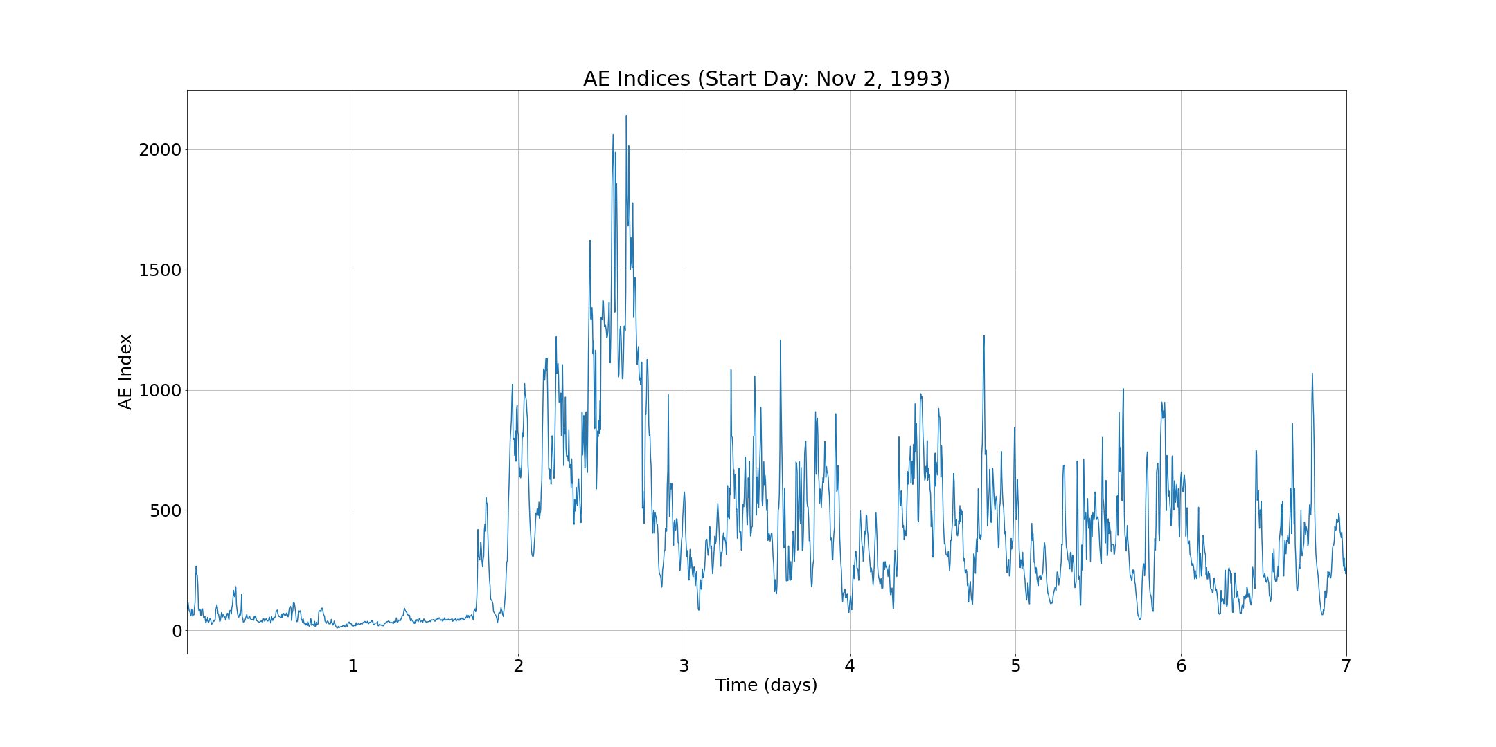
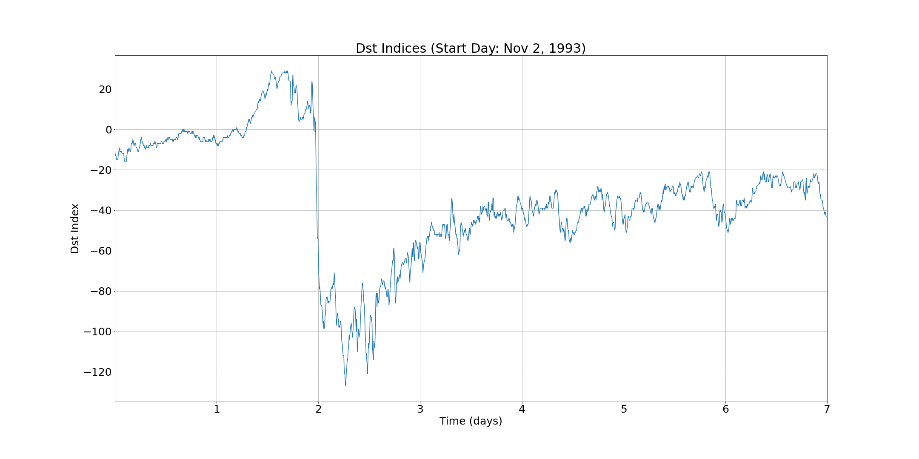

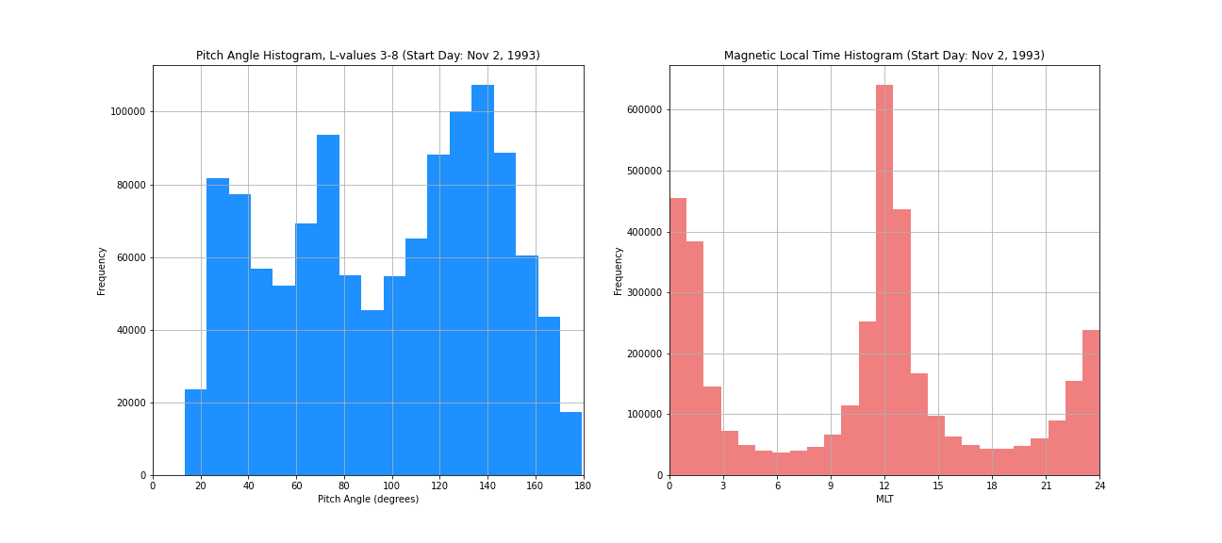

Storm 8: 1993306-1993312
No microbursts before main phase
Storm type 1
Chosen for report

Slide 10
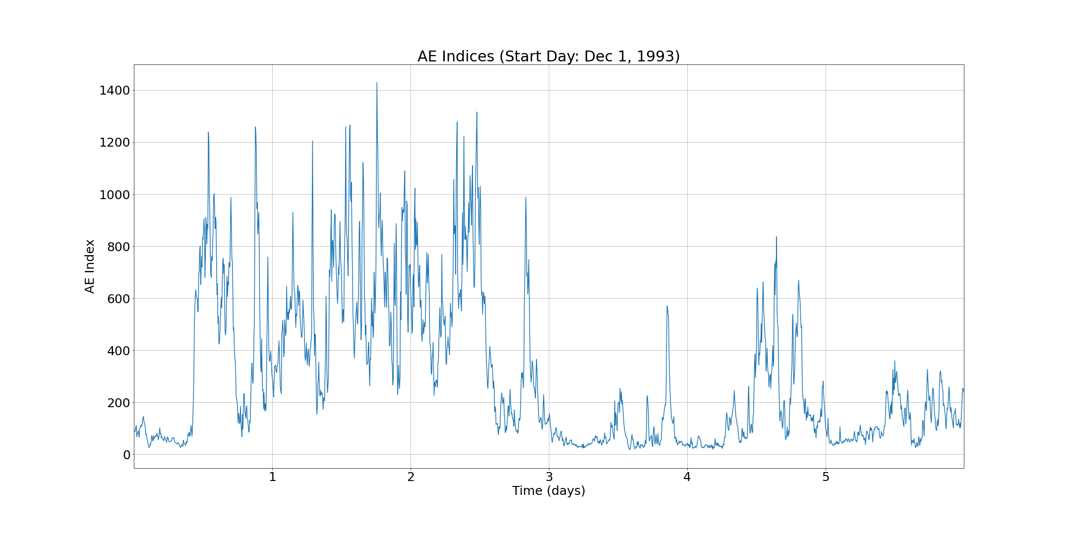
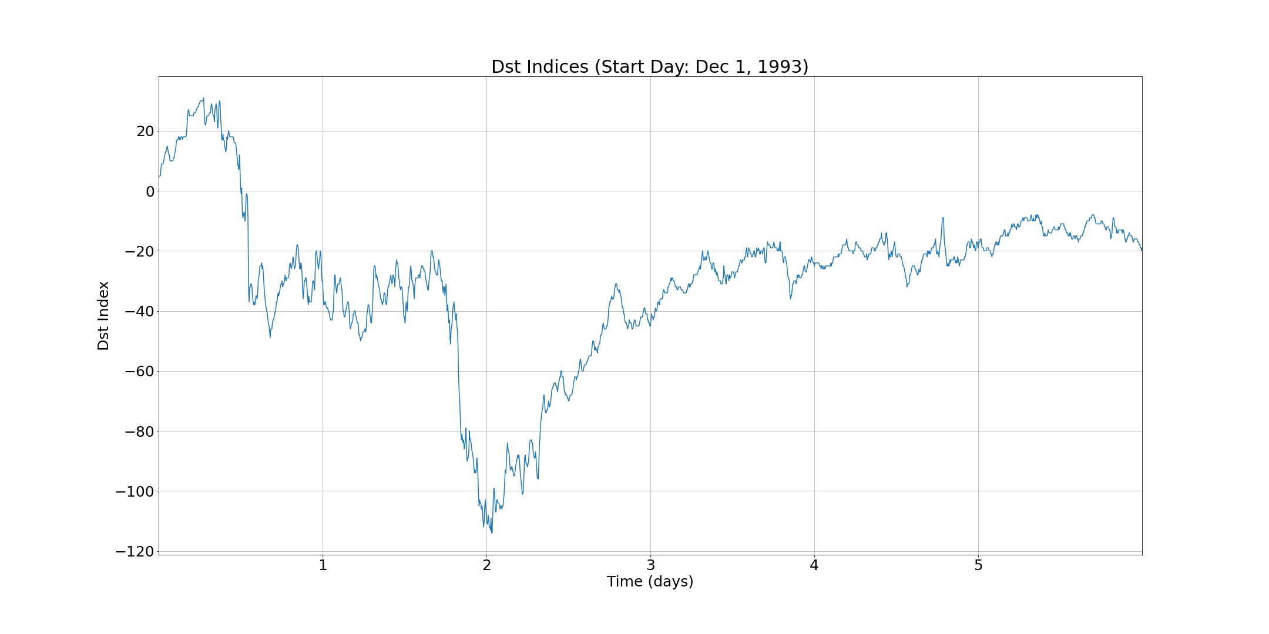

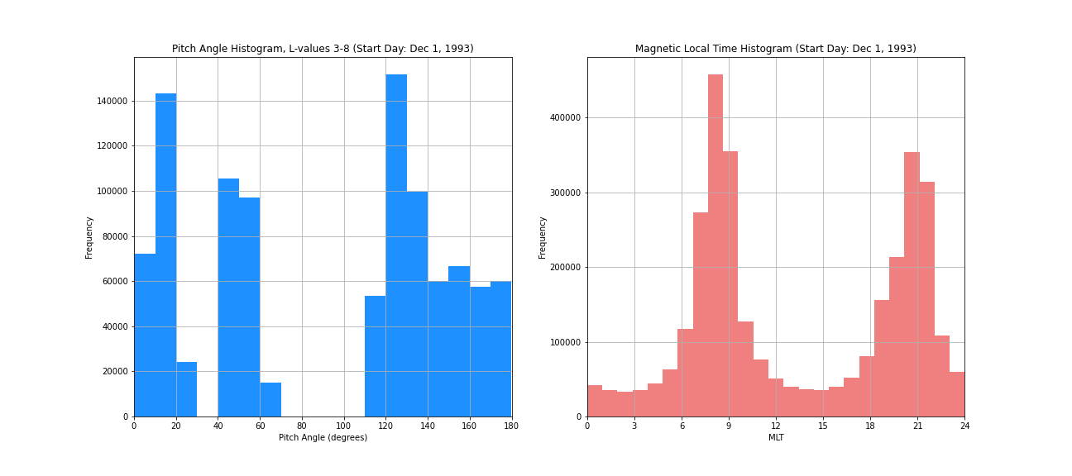

Storm 9: 1993335-1993340
Irregular storm

